Slide 2
Welcome & Umbrella Update
Prof. Jonathan Ross – Clinical Lead for Pharmacy

Slide 3


Slide 4
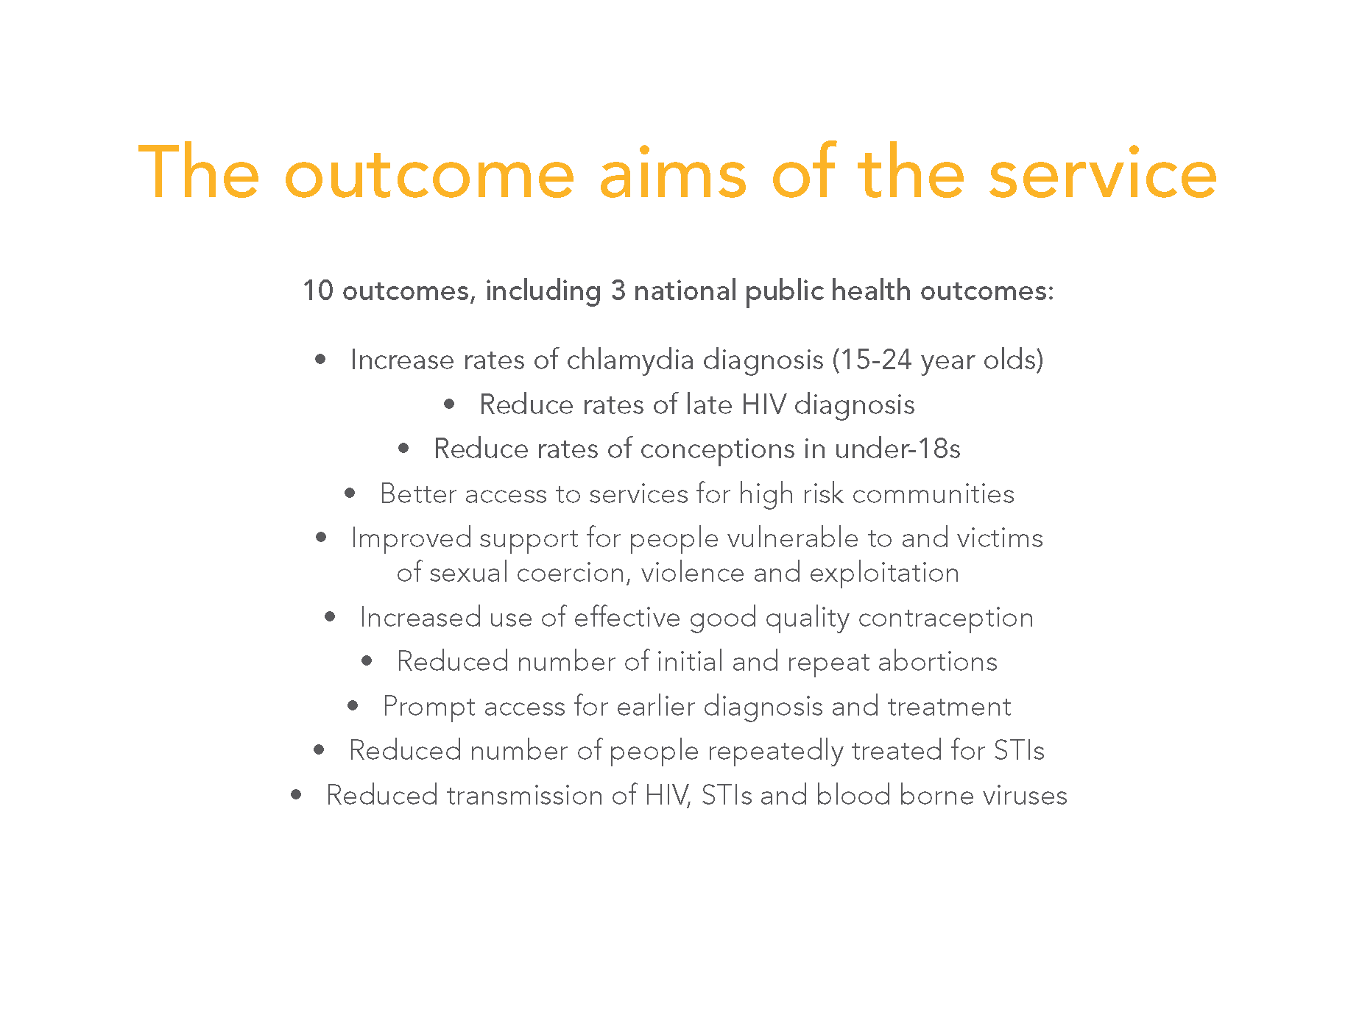

Slide 5
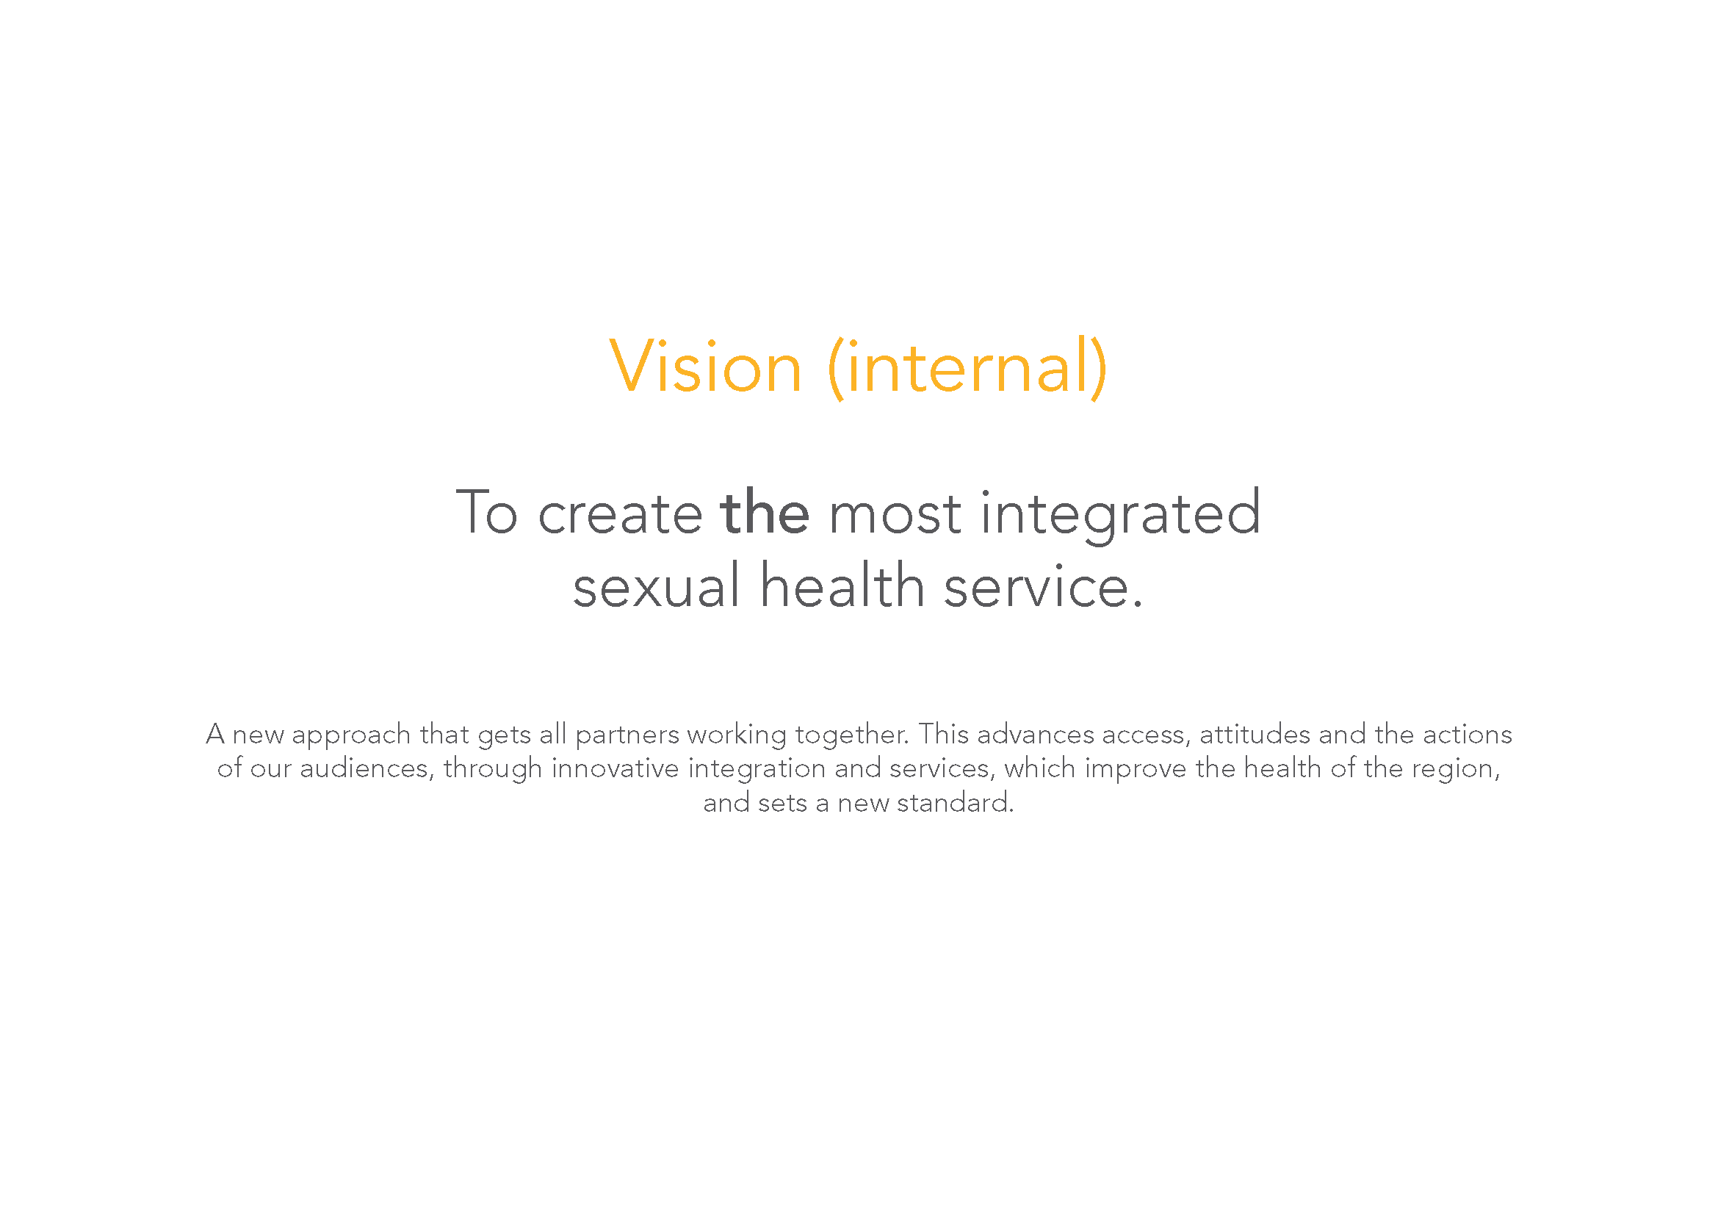

Slide 6

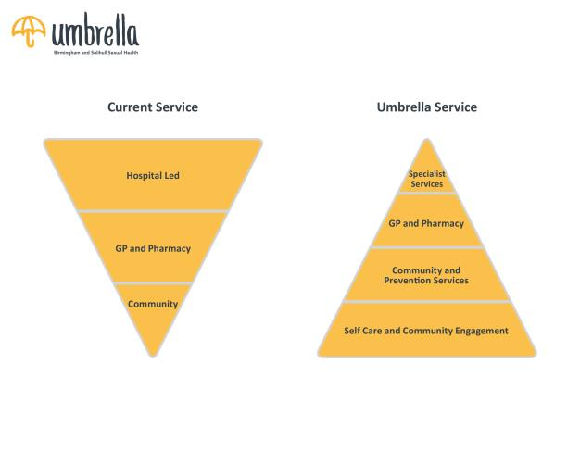
Umbrella model of care
Health Promotion - changing behaviour through education and awareness
Self care – empowering patients to care for themselves
Local services – embracing a wide network of community-based facilities
Primary Care – transforming access to care
Specialist services – dedicated centres for Sexual Health

Slide 7

Why change?
New model offers:
Improved access to services
One-stop-shop for service users
Emphasis on prevention
Joined-up multi-agency approach
Improved outcomes

Slide 8
Clinics

Slide 9
Clinical Services
Whittall Street Clinic (B’ham city centre)
Boots Birmingham (city centre)
Boots Solihull (Mell Square)
Erdington (New Attitudes)
Soho Road
Northfield
Hawthorn House (Heartlands Hospital site)
Chelmsley Wood Primary Care Centre

Slide 10
Sexual health clinic activity*
Notes:
Solihull ~800/month, 50-60% <25
Chelmsley Wood ~100/months, 50% <25

Slide 11
Community

Slide 12
Where in the community?
83 Tier 1 and Tier 2 pharmacies
Over 100 GP practices
SAFE in Ladywood Community Centre
BLGBT Centre - weekly and monthly
SIFA Homeless Centre - weekly
6 Youth and Community Centres - fortnightly
Health & Wellbeing clinics
Online – umbrellahealth.co.uk
At Home – self testing kits

Slide 13
Pharmacies

Slide 14
Pharmacies
Pharmacies in Birmingham offer a wider range of sexual health interventions in addition to emergency hormonal contraception (EHC), which Solihull residents can access freely.

Slide 15
Pharmacy Services
Tier 1:
  EHC,
  advance provision of emergency contraception,
  condom distribution and
  dispense STI kits
  Umbrella currently have 84 Tier 1 pharmacies and are looking to increase this as well as the activity taking place at these locations

Slide 16
Pharmacy Services
Tier 2:
  Tier 1 services PLUS:
  initiate STI testing and provide STI kits,
  Hep B vaccination,
  Initiate contraceptive pill and injections and
  Dispense and administer ongoing contraceptive injections
  Umbrella currently have 13 Tier 2 pharmacies and are looking to increase this as well as the activity taking place at these locations

Slide 17
Current Issues
  STI kits, this included
    Lancet – there are being changed
    3 systems – we are aware of this, we will be trialling tablet devices at Tier 2 pharmacies to see if this reduced time taken
  Condoms – later slide
  Email Address – Now managed by operations team
  Training – refresher training is currently taking place and more training will be scheduled for end of the year

Slide 18
Notes:
Purple star is pharmacy campaign - May 16

Slide 19
Notes:
Purple star is pharmacy campaign - May 16

Slide 20
Website

Slide 21
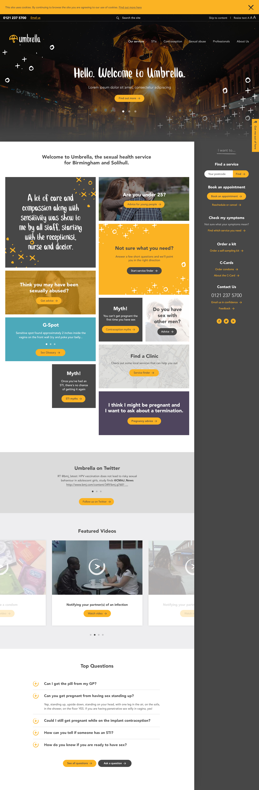
Website

Slide 22
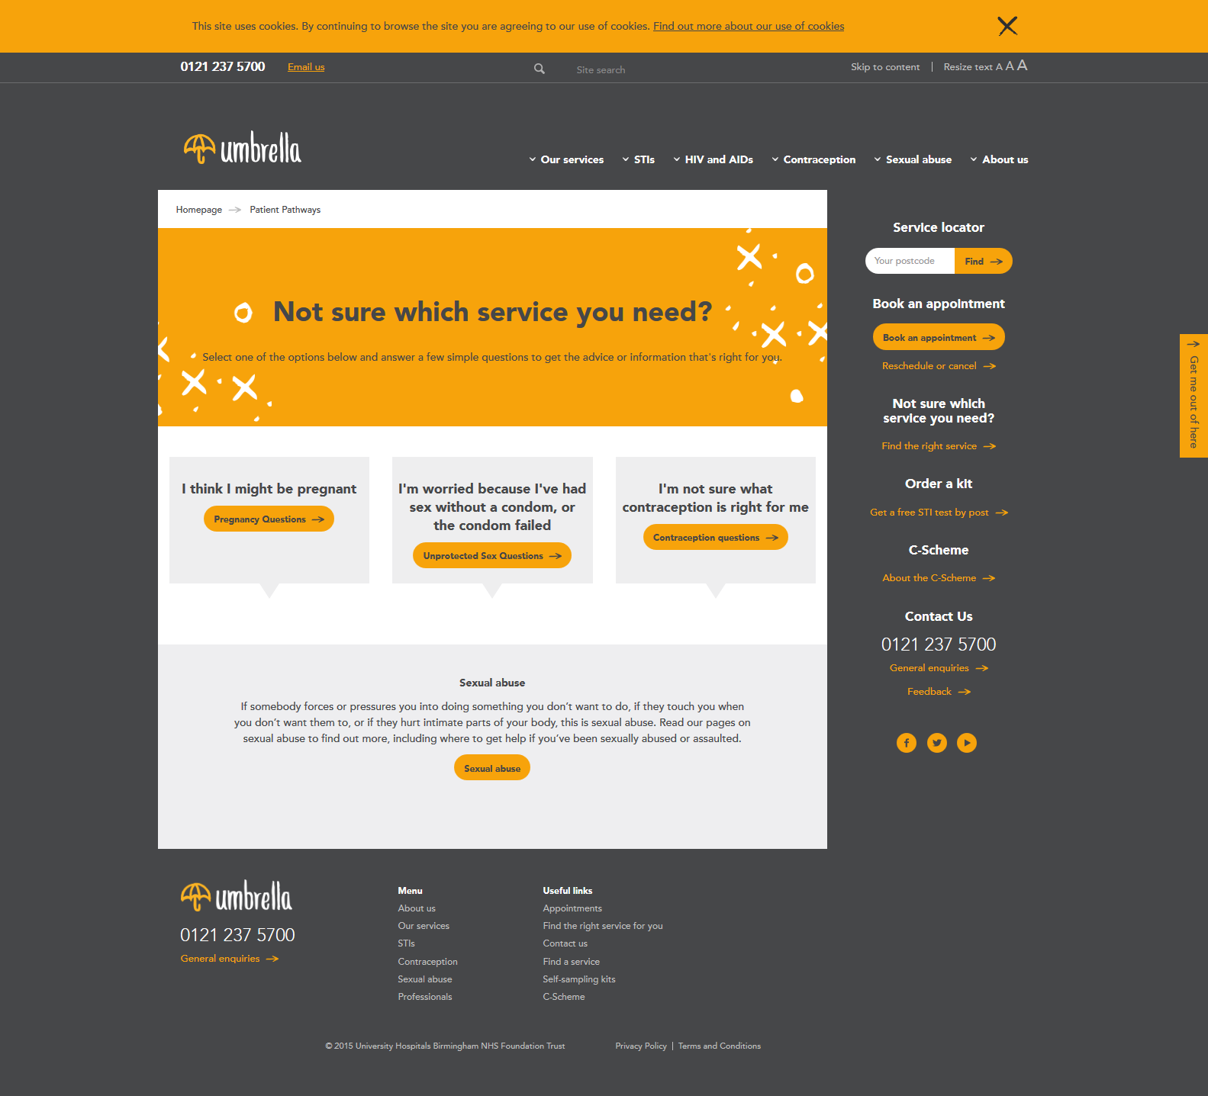
Website

Slide 23
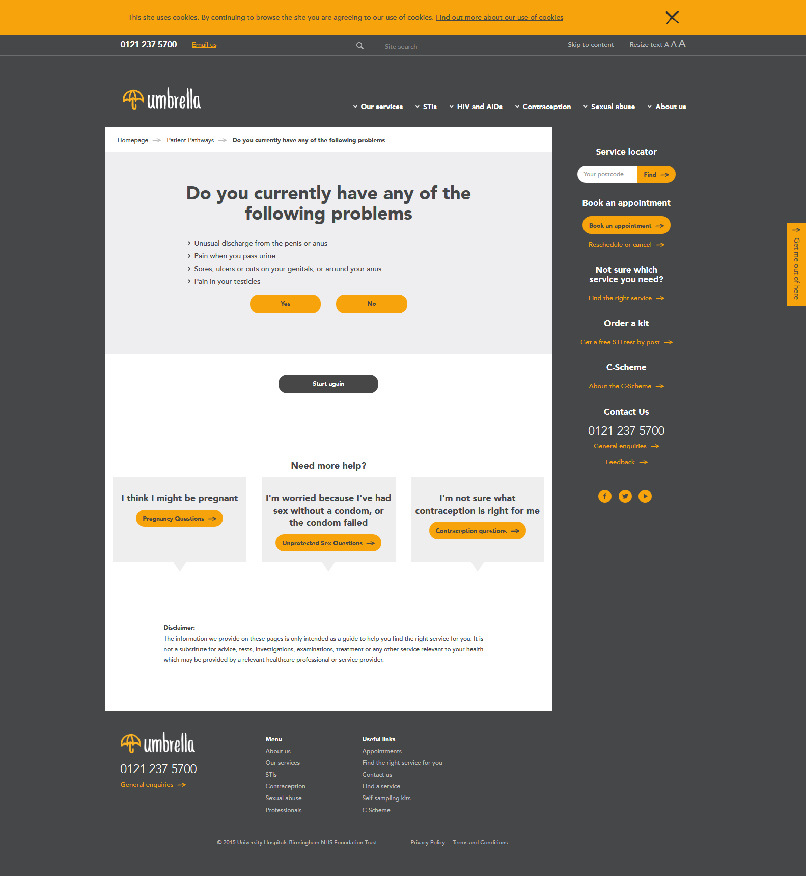
Website

Slide 24
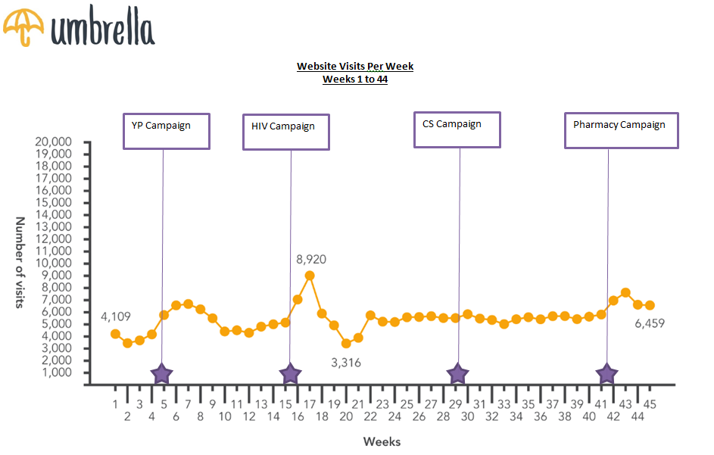
Sexual health Website*
Notes:
Purple Stars are Campaigns: Sept 15 – YP, Nov 15 – HIV, Feb 16 – CSP, May 16 - Pharmacy

Slide 25
STI kits and Chlamydia Screening

Slide 26
Home STI kits issued*
Notes:
Purple Stars are Campaigns: Sept 15 – YP, Nov 15 – HIV, Feb 16 – CSP, May 16 - Pharmacy

Slide 27
Home STI kits Returned*
Notes:
Purple Stars are Campaigns: Sept 15 – YP, Nov 15 – HIV, Feb 16 – CSP, May 16 - Pharmacy

Slide 28
STI positivity rate by infection*
Notes:
Purple Stars are Campaigns: Sept 15 – YP, Nov 15 – HIV, Feb 16 – CSP, May 16 - Pharmacy

Slide 29
Overall CSP
*Overall CSP - includes Hub, Satellite, self sampling, youth and community
Location | Clinics | Community | Home | Total
Tested | 15293 | 233 | 5387 | 20,913
Positive | 2032 | 22 | 456 | 2,510
% Positive | 13.29% | 9.44% | 8.46% | 12.00%

Slide 30
Umbrella Activity

Slide 31
Total Umbrella Activity – for Pharmacy, STI kits issued to home addresses and Clinic Attendances*
Type/Month | Aug | Sept | Oct | Nov | Dec | Jan | Feb | Mar | Apr | May | June | Totals
Pharmacy | 262 | 679 | 866 | 673 | 669 | 773 | 952 | 822 | 724 | 968 | 878 | 7,388
STI kit home & Other issued | 408 | 1,075 | 974 | 1,232 | 1,053 | 1,247 | 1,384 | 1,160 | 1,099 | 1,214 | 1,190 | 10,943
Clinic Attendances - All | 4,693 | 8,555 | 8,413 | 8,311 | 7,956 | 8,367 | 8,678 | 8,405 | 8,499 | 8,055 | 8,318 | 80,671,
Totals | 5,363 | 10,309 | 10,253 | 10,216 | 9,678 | 10,387 | 11,014 | 10,387 | 10,322 | 10,237 | 10,386 | 99,002
Notes:
Purple Stars are Campaigns: Sept 15 – YP, Nov 15 – HIV, Feb 16 – CSP, May 16 - Pharmacy

Slide 32
Notes:
Purple Stars are Campaigns: Sept 15 – YP, Nov 15 – HIV, Feb 16 – CSP, May 16 - Pharmacy

Slide 33
Useful Email Addresses
If your query relates to training please email umbrellatraining@uhb.nhs.uk
If your query relates to condoms please email umbrellaordering@uhb.nhs.uk
If your query relates to STI or Chlamydia kits please email umbrellaselftestkitmicrobiology@uhb.nhs.uk
If your query is generic please email umbrellapartners@uhb.nhs.uk
If your query relates to Contracts or Finance please email uhb-tr.Umbrellacontracts@nhs.net

Slide 34
Procurement Process
Pam Kelsall - Corporate Procurement Specialist

Slide 35
Main Contract
UHB won a 5 year contract with BCC/SMBC
Contract runs from August 2015 to August 2020
Optional 2 year extension
UHB procured a number of partners
GP, Pharmacy, Facility, Access, Promotion, Support, Pathology
Collectively known as ‘Umbrella’

Slide 36
2015 Procurement:
97 pharmacies appointed
84 Tier 1 status and 13 Tier 2 status
Feedback was that procurement was an administrative burden
Contract too long and complex
Optional 2 year extension
Contract contained provisions that some pharmacies couldn’t sign up to

Slide 37
New Procurement:
Need to appoint additional pharmacies going forward
New method of procurement
Dynamic Purchasing System (DPS)
DPS is different to traditional procurement framework
Used successfully by Dorset and Kent County Councils

Slide 38
What is a DPS:
Completely electronic system
Two lots – Tier 1 and Tier 2
Allows new pharmacies to join at any time
Pharmacies who don’t initially meet selection criteria for Tier 2 can reapply at a later stage
Once accepted onto DPS no need to reapply unless applying for a different lot
Flexibility to appoint additional pharmacies in specific wards

Slide 39
Invitations to Tender (ITT):
UHB will undertake Tender Rounds as and when we need to appoint pharmacies to provide services
All pharmacies admitted to the DPS on the relevant lot at the time ITT is issued will be invited to tender
ITT for Tender Round 1 will be issued on 1 September.
Contract start date 5 December 2016

Slide 40
Current Contracts:
Tender Round 1 is to appoint Tier 1 and Tier 2 pharmacies across all wards in Birmingham
Current contracts will all be terminated and current providers will need to reapply
Necessary as going forward all providers need to be admitted to the DPS to tender for Pharmacy Partner Opportunities
Contracts awarded under Tender Round 1 will run until August 2020

Slide 41
New Subcontract:
Considerably reduced in length
Short form clauses where possible
New Subcontract will be published in draft
Opportunity to submit comments
However you must sign up to final version

Slide 42
How do you apply:
Pre-Qualification Questionnaire will be published this week
Complete on-line Pre-Qualification Questionnaire (PQQ)using Bravo e-tendering system
PQQ responses must be submitted electronically. We cannot accept responses via the post, hand-delivered or sent by email.
PQQs must be submitted online by noon on 17th August
Make sure you allow time to upload your PQQ

Slide 43
Pre-qualification Questionnaire:
PQQ assesses pharmacies on a number of mandatory criteria
Legal grounds for exclusion
Insurance
Equality and diversity
Environmental
Health and Safety
8 – 11 technical questions intended to evaluate a pharmacy’s capability to deliver the contract

Slide 44
What happens next:
All questions evaluated on a Pass/Fail basis - no scoring
Pharmacies who pass all the questions will be admitted to the DPS
Pharmacies will be notified via Bravo if they have been successful or unsuccessful
Getting through the PQQ does not constitute award of services
Successful pharmacies invited to tender

Slide 45
How do you respond:
Complete on-line Tender Questionnaire using Bravo e-tendering system
Tenders must be submitted electronically. We cannot accept responses via the post, hand-delivered or sent by email.
Tenders must be submitted online by noon on 27 September 2016
Make sure you allow time to upload your Tender

Slide 46
Question Types:
Generic questions – these questions only need to be answered once. These include:
Business Continuity
Staff Training
Safeguarding
Information Governance
STI Screening
Effective promotion of services
Patient feedback

Slide 47
Question Types:
Location specific questions – these questions have to be answered for each pharmacy location. These include:
Prescriptions
Location of pharmacy
Accessibility
Service availability
Skills

Slide 48
Evaluation:
The tender documents will make clear what weighting is given to each criteria and how they will be scored
Marking Scheme for Generic Questions can be found in ITT document
Marking Scheme for Location Specific Questions can be found underneath each question
All questions are scored from 0 to 5

Slide 49
Evaluation:
UHB will evaluate and score all tenders strictly against the criteria set out in the ITT documents
A ranked list will be produced for each Lot and BCC ward
Target number of pharmacies for each BCC ward set out in ITT

Slide 50
What happens next:
Pharmacies will be notified if their tenders have been successful or unsuccessful
Feedback will be provided to all pharmacies who submitted a bid
Unsuccessful pharmacies will be given feedback on what score they received and the scores/characteristics of the winning bidders
10 day “standstill period” to allow any challenges to be lodged

Slide 51
How much will you be paid?::
Emergency Hormonal Contraception | £12 + drug tariff
Advance provision of emergency contraception | £12 + drug tariff
Condom distribution | £1.50 (+ condoms f.o.c)
Dispense STI testing kits | £2.50 (+ kit f.o.c)
Initiate STI testing and provide kits | £15 (+ kit f.o.c)
Hepatitis B vaccination | £10 + drug tariff

Slide 52
How much will you be paid?::
Service | Unit Price
Initiate combined oral contraception, progesterone only oral contraception and contraception injections | £15 + drug tariff (oral) £20 + drug tariff (injectable)
Dispense and administer ongoing contraception injections | £10 + drug tariff
Dispense treatment for Chalmydia | £10 + drug tariff

Slide 53
Bravo portal:
The Bravo portal is an electronic tendering system
Registration is free for suppliers and will give you visibility of tendering opportunities
To register please go to https://heartofengland.bravosolution.co.uk
and follow the instructions

Slide 54
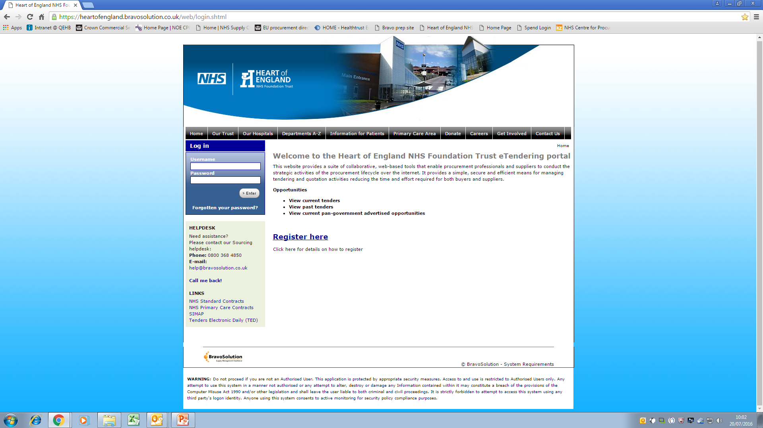
Bravo portal:

Slide 55
What is e-tendering;
E-tendering is the carrying out of the tendering process using electronic means. Including:
Potential providers accessing the tender process
On-line questions to complete
Communication between the potential providers and UHB

Slide 56
How to Get Support:
If you require assistance using the Bravo portal please contact the Bravo Technical Support Team. Contact details are below:
For assistance please contact the Helpdesk operated by BravoSolution:
Open Mon to Fri 8am to 6pm
Freephone: 0800 368 4850
email: help@bravosolution.co.uk

Slide 57
thank you
0121 237 5700
umbrellahealth.co.uk
umbrella@uhb.nhs.uk

